Slide 1


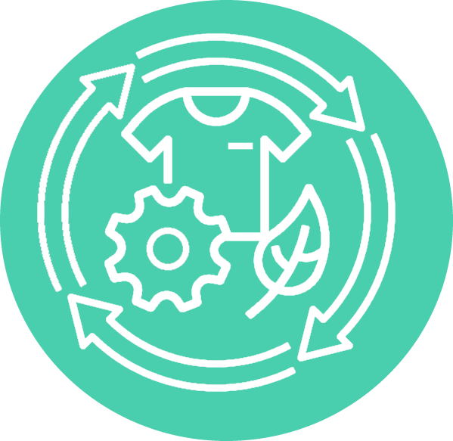




AIdesignTEX
© Templateswise.com
Innovative IT tools for a circular textile economy: driving sustainability and resource efficiency.
Prof. Katarzyna Grabowska​
Dean of Faculty of Material Technologies and Textile Design
Lodz University of Technology​
116 Zeromskiego Street​
90-543 Lodz, Poland
​
​
Notes:
I would like to warmly welcome all of you to the kick-off meeting of the AIdesignTEX project. It is a great pleasure to host such an esteemed group of partners, experts, and representatives of our institutions. I hope that today’s discussions and exchange of experiences will provide us with valuable insights and help us achieve our shared goals. Thank you for joining us, and I wish you a fruitful meeting. Now, I would like to hand over the floor to the Rector.

Slide 2
Project Introduction
Project Coordinator:
Prof. Katarzyna Grabowska,
Dean of the Faculty of Material Technologies
and Textile Design,
Lodz University of Technology​
Notes:
Kasia wraca do project introduction

Slide 3
MEETING AGENDA
TIME | SESSION | SPEAKER
09:00-09:30 | Welcome coffee
09:30-10:30 | Start of the Meeting, Welcome Word and Introduction | TUL
10:30-11:10 | Presentation of the Partners | TUL, GU, UiS, UCAV
11:10-11:30 | Coffee Break
11:30-12:30 | Project Work Plan, Budget Allocation and Partner Responsibilities | TUL
12:30-13:00 | Q&A Session | TUL
13:00-14:00 | Visiting of the Faculty of Material Technologies and Textile Design
14:00-15:00 | Lunch

Slide 4
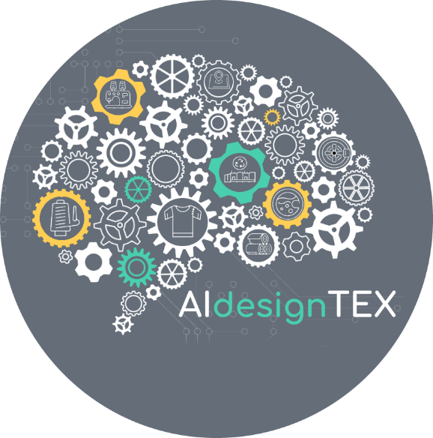

Call details AIdesignTEX
Project acronym: AIdesignTEX​
Project title: Innovative IT tools for a circular textile economy: driving sustainability and resource efficiency.
Project number: 101159060
Funding Scheme: HORIZON-WIDERA-2023-ACCESS-02
Start date of the project: 01st October 2024
Duration: 36 months till: 30th September 2027​
Budget: 1 498 183.75 Euro​
Project coordinator name: Prof. Katarzyna Grabowska,
Lodz University of Technology​
Tel: +48 42 631 33 00
Project coordinator e-mail: katarzyna.grabowska@p.lodz.pl​
Notes:
This is the kick-off meeting for the AldesignTEX project, funded under the Horizon Europe Widera 2023 program. The project will last 36 months, with a total budget of [insert amount]. The coordinator of the project is Łódź University of Technology, and I, Katarzyna Grabowska, have the pleasure of being the project coordinator. Our goal is to develop innovative solutions in textile technologies, bringing new opportunities to the industry. Today, we will discuss the detailed project schedule and the key objectives we aim to achieve in the coming months.

Slide 5
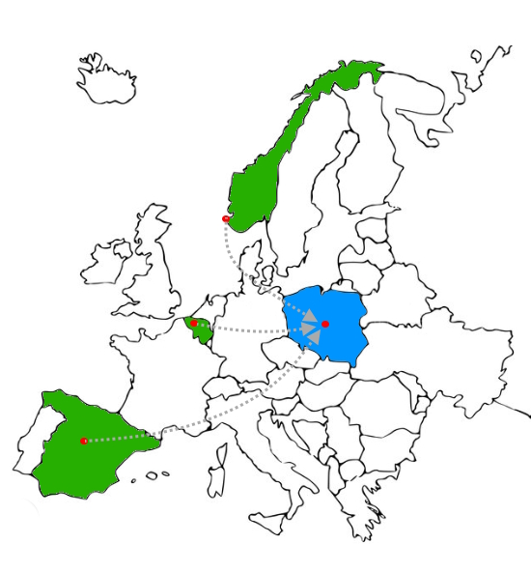
Main objective AIdesignTEX
UiS – University of Stavanger
Department of Mechanical and Structural Engineering and Materials Science (IMBM)
The AIdesignTEX project's general objective is to establish a long-term partnership between TUL and high-ranking counterparts among EU peers through networking activities.
The networking and partnership implemented in the project will raise the institutional research and administration profile of TUL in the textile production design processes
by utilizing artificial intelligence and machine learning tools to develop textiles that are more easily recyclable or biodegradable.
UG - Ghent University
Department of Materials, Textiles
and Chemical Engineering
TUL - Łódź University of Technology
Faculty of Materials Technologies and Textile Design
UCAV - Catholic University of Avila Department of Entrepreneurship and Management
Notes:
The AIdesignTEX project aims to establish long-term collaboration between Łódź University of Technology and leading European partners, such as the University of Stavanger in Norway, Ghent University in Belgium, and the Catholic University of Ávila in Spain. This collaboration will be realized through networking activities. By implementing this project, the research and administrative profile of Łódź University of Technology will be strengthened, especially in the area of textile production process design. The use of artificial intelligence and machine learning tools will enable the development of more sustainable textiles that are easier to recycle or biodegrade.
I would like to warmly welcome and introduce our partners:
From the University of Stavanger: Chandima Ratnayake Mudiyanselage,
From Ghent University: Professor Karen De Clerck and Sofie Moorkens,
From the Catholic University of Ávila: Professors Ricardo Reier and Miguel Ángel Gutiérrez.
I would also like to introduce our team from Łódź University of Technology:
Monika Malinowska-Olszowy – as Vice-Dean for Education,
Marcin Barburski – Vice-Dean for Development,
Anna Bacciarelli-Ulacha – Project Administrator,
Małgorzata Michalak – financial specialist,
Katarzyna Szypułka – administration office.
Finally, I would now like to ask our partners and team members to say a few words about themselves and their work. This is an excellent opportunity to get to know each other better and understand what experiences and competencies each of us brings to this project.

Slide 6

Presentation of Partners
Project coordinator: Prof. Katarzyna Grabowska,
Lodz University of Technology​
Notes:
In our agenda, this is the moment for the partner presentations. So, at the beginning, I would like to briefly introduce the city of Łódź, the Łódź University of Technology, and the Faculty of Material Technologies and Textile Design.

Slide 7
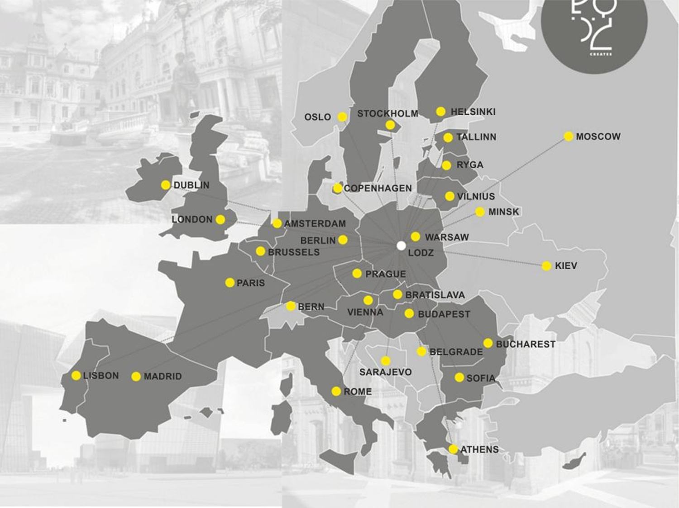
Lodz is located in the center of Europe and is one of the largest cities in Poland
The city of unique historical and cultural heritage, constantly changing and developing.
Notes:
Thanks to a rich textile industry heritage, Łódź is the perfect place to carry out innovative initiatives like the AIdesignTEX project, which aims to combine traditional textile production methods with modern technologies such as artificial intelligence and machine learning. This cultural heritage of textile production in Łódź gave rise to the Faculty of Material Technologies and Textile Design, which has been dedicated to advancing this field. Our goal is to support the sustainable development of this sector, which has shaped the city for years.

Slide 8
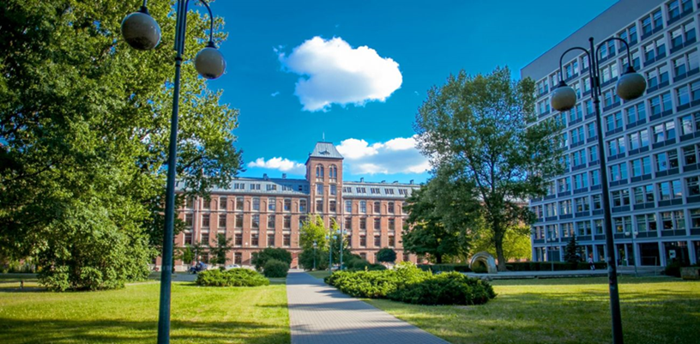
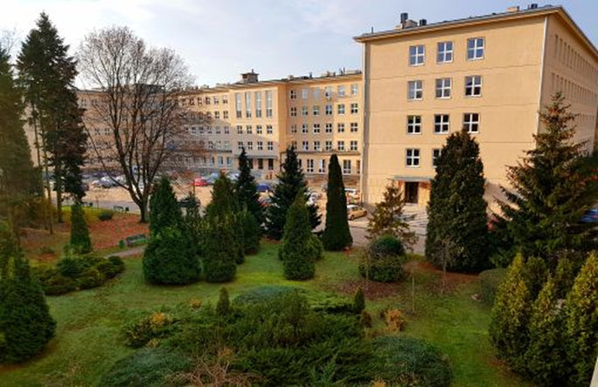
Lodz University of Technology AIdesignTEX
Lodz University of Technology:
2 237 academic staff,
13 050 students,
573 Ph.D. students,
110 000 graduates,
60 fields of study,
9 faculties
International Faculty of Engineering (IFE),
International Doctoral School (IDS)
Notes:
Lodz University of Technology is one of the best technical universities in Poland. It is proud to have been educating engineers for
75 years. Over 120,000 well educated graduates are the fruit of the work of several generations of well-prepared staff: teaching, research
and technical staff, as well as professional administrative suport.
We are a dynamic technical university with an established structure, we provide education to over 13 thousand students and employ 2.7 thousand staff.
Teaching is delivered at nine faculties.

Slide 9
Faculty of Material Technologies and Textile Design AIdesignTEX
Institute of Textiles​
Department of Chemistry and Physical Chemistry of Polymers​
Department of Material Science, Commodity Science And Textile Metrology​
Department of Yarns, Nonwovens And Polymer Composites Technology​
Department of Sustainable Development And Textile Marketing​
Department of Knitting Technologies And Textile Machines​
Institute of Architecture of Textiles ​
Textile and Clothing Architecture ​
Fabric Technology and Construction​
Clothing and Textronics ​
Visual Communication​
3. Department of Mechanical Engineering, Technical Informatics
and Chemistry of Polymer Materials​
​
Main field of studies at the Faculty are:​
Textile Engineering​
Textile and Fashion Industry​
Design​
Notes:
The Faculty of Material Technologies and Textile Design focuses on innovative research in textile production, sustainability, and design, making it an important part of creating materials and processes for the future.
By combining traditional skills with modern technology, the faculty is leading the way in developing sustainable solutions for the textile industry.
The Faculty of Material Technologies and Textile Design consists of three main units: the Institute of Textiles, the Institute of Architecture of Textiles, and the Department of Mechanical Engineering, Technical Informatics, and Chemistry of Polymers. Within the faculty, various departments and institutes focus on areas like yarn and nonwovens technology, textile and clothing architecture, and sustainable development and textile marketing. The main fields of study include Textile Engineering, the Textile and Fashion Industry, and Design

Slide 10

Presentation of Partners
Prof. R.M. Chandima Ratnayake, Dr.,
Department of Mechanical and Structural Engineering and Materials Science,
University of Stavanger
Notes:
Dear Partners, now I give the floor to you. Please proceed with the presentation of your universities.

Slide 11

Presentation of Partners
Prof. Karen De Clerck ,
Department of Materials, Textiles and Chemical Engineering,
Ghent University

Slide 12

Presentation of Partners
PhD. Ricardo Reier Forradellas
Director of Ávila Business School,
Faculty of Social Sciences and Law,
Catholic University of Ávila

Slide 13
Project Budget
Małgorzata Michalak,
Lodz University of Technology​
Notes:
Now, I would like to ask Małgorzata Michalak to take a flor. Małgorzata will provide insights on the budget and expenditure.

Slide 14
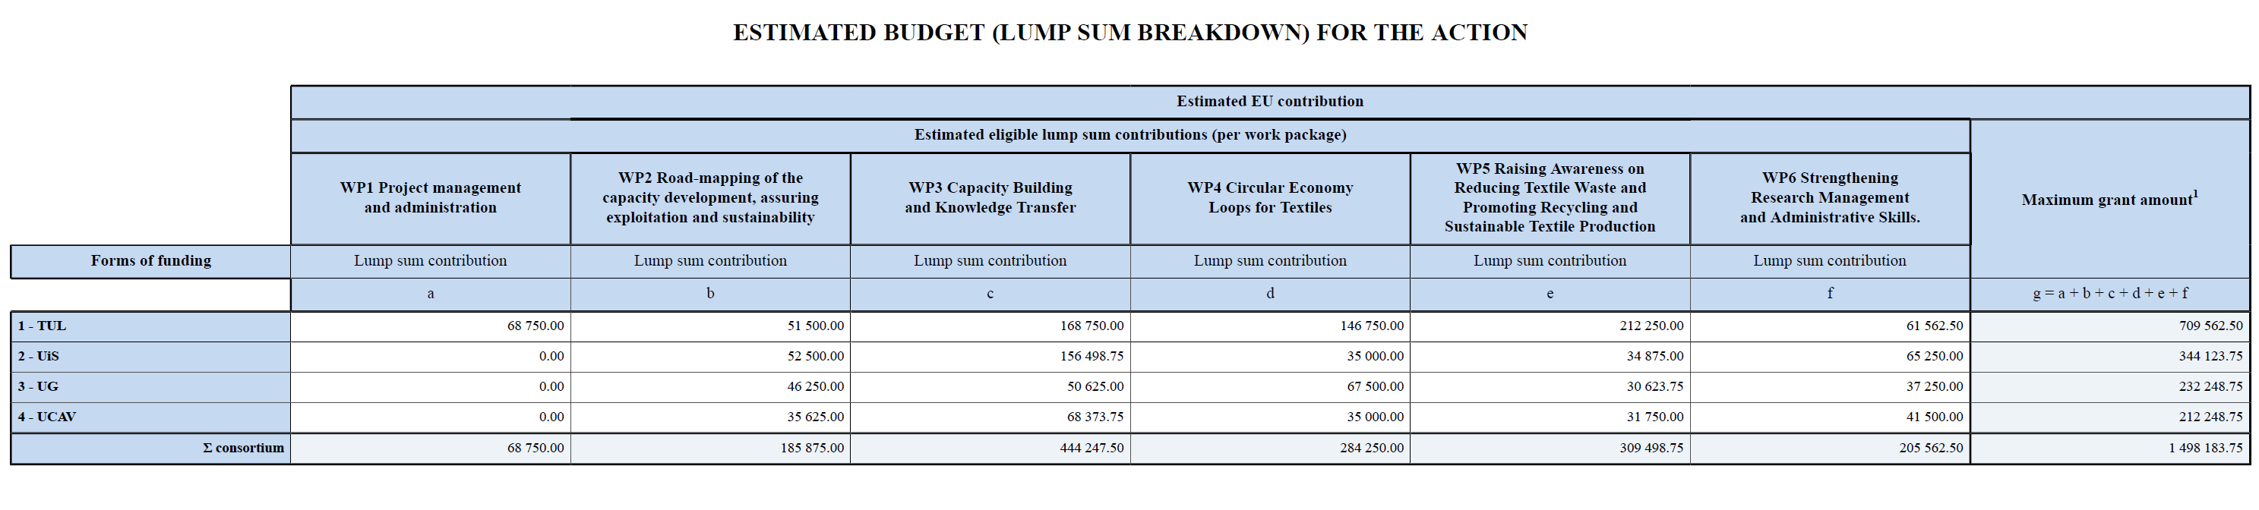
Project budget AIdesignTEX

Slide 15
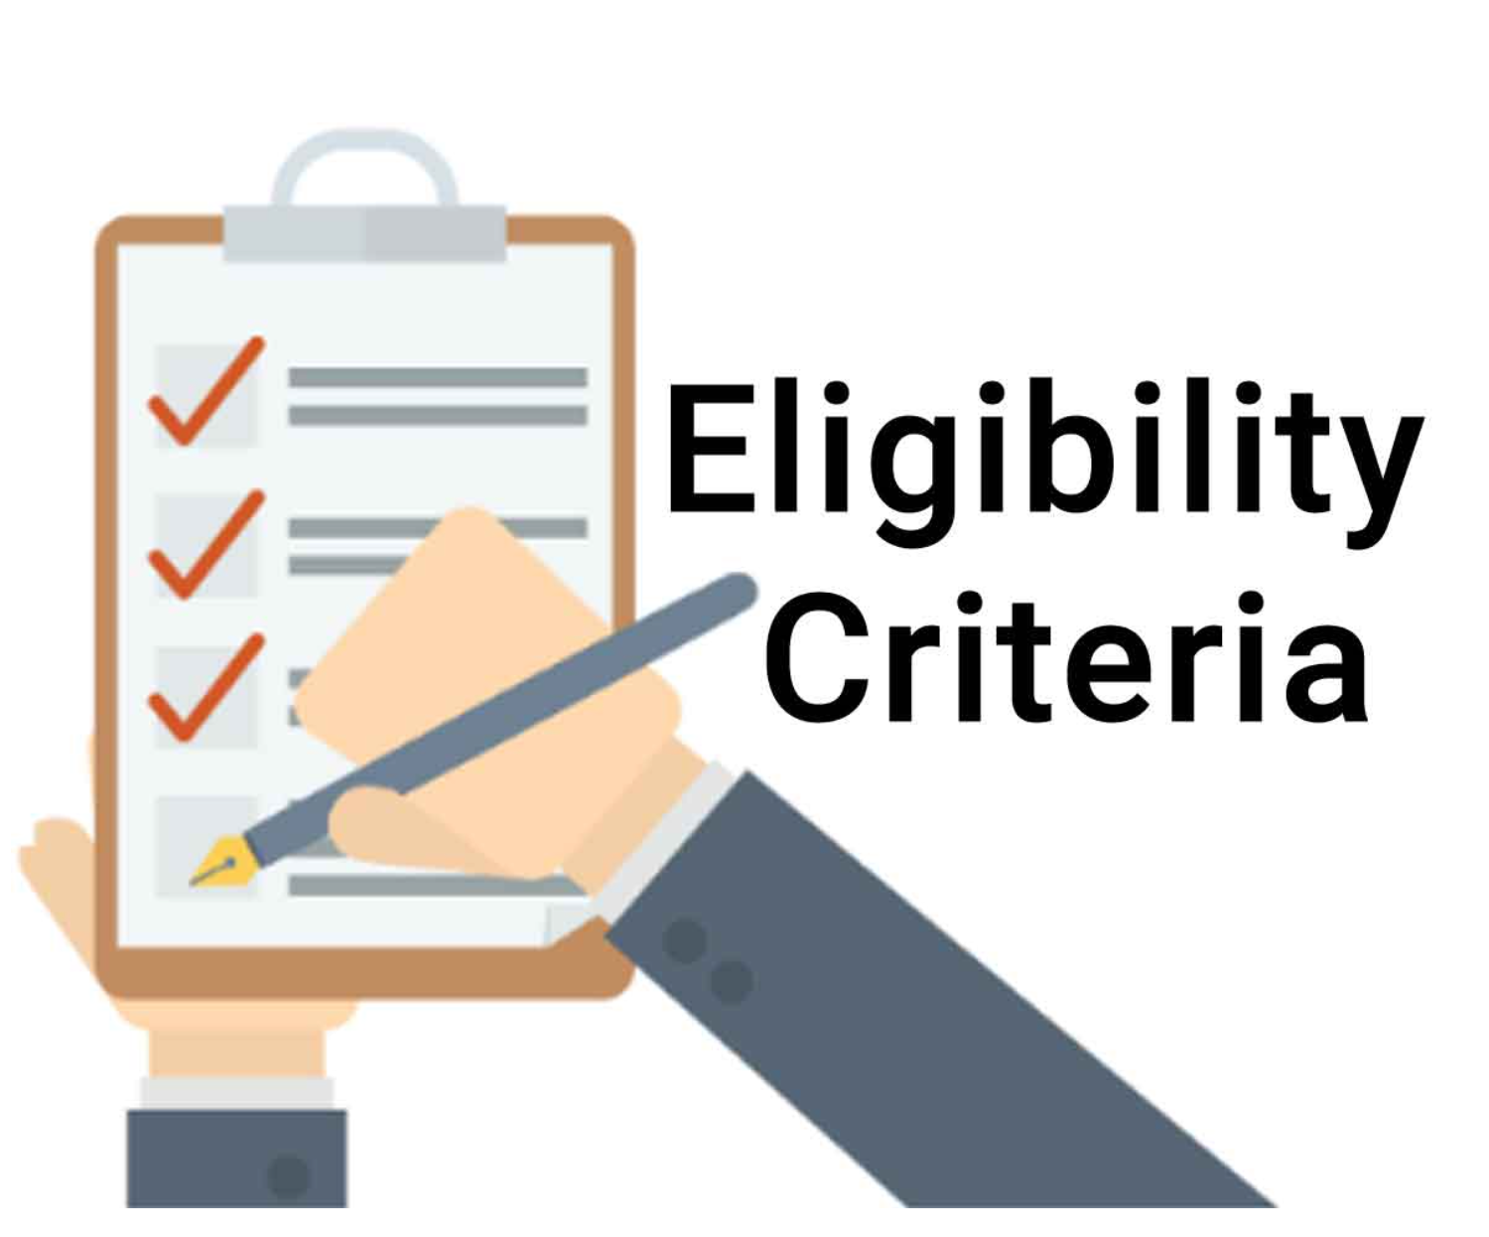
Project budget AIdesignTEX
GENERAL AND SPECIFIC ELIGIBILITY CONDITIONS
Lump sum contributions are eligible, if:
(a) they are set out in Annex 2 (Project’s budget)
(b) the work packages are completed and the work is properly
implemented by the beneficiaries and/or the results are achieved,
in the period set out in the Project.

Slide 16
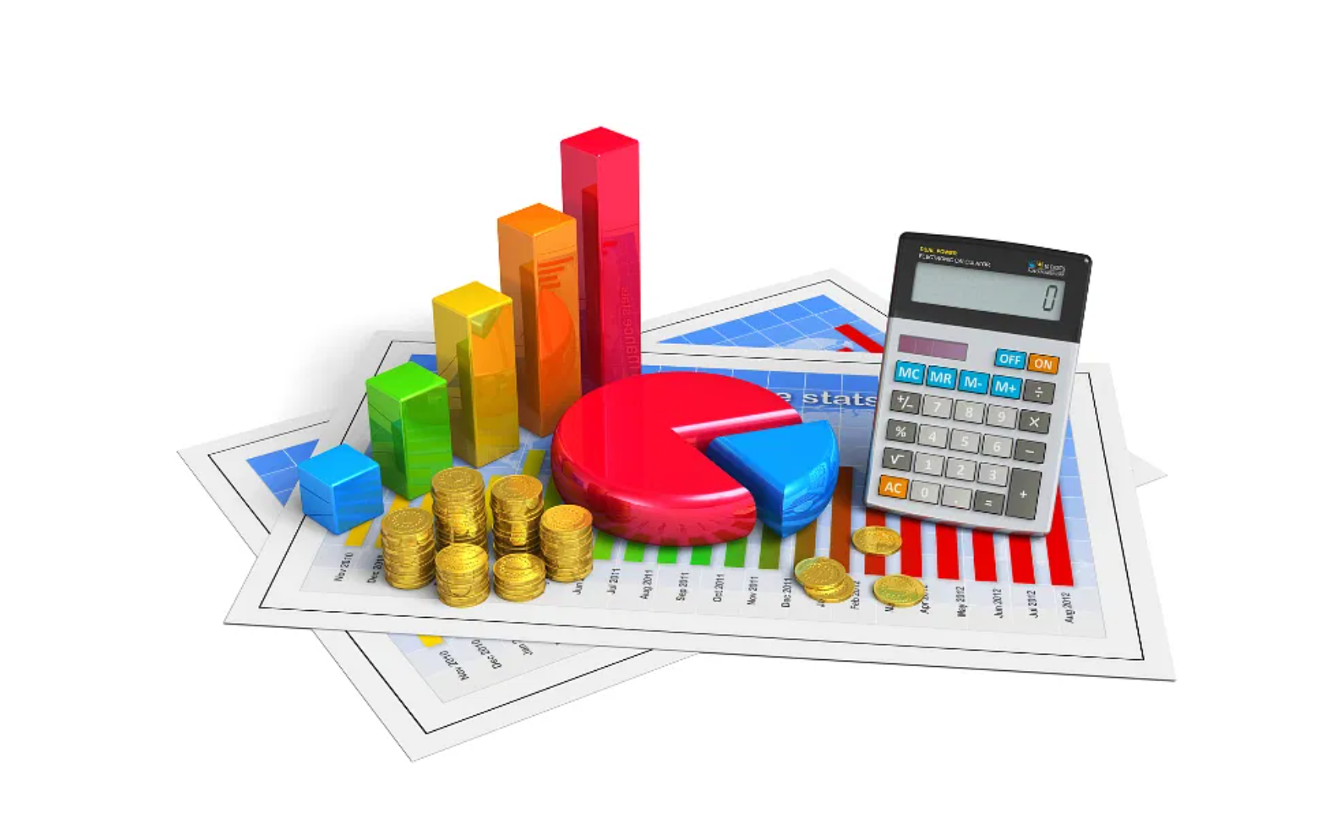
Project budget AIdesignTEX
CHANGES TO BUDGET
Amendments for transfers between work packages are moreover possible only if the work packages concerned are not already completed (and declared in a financial statement) and the transfers are justified by the technical implementation of the action.
CATEGORIES WITH LUMP SUMS COSTS OR CONTRIBUTIONS ALWAYS REQUIRE AN AMENDMENT

Slide 17
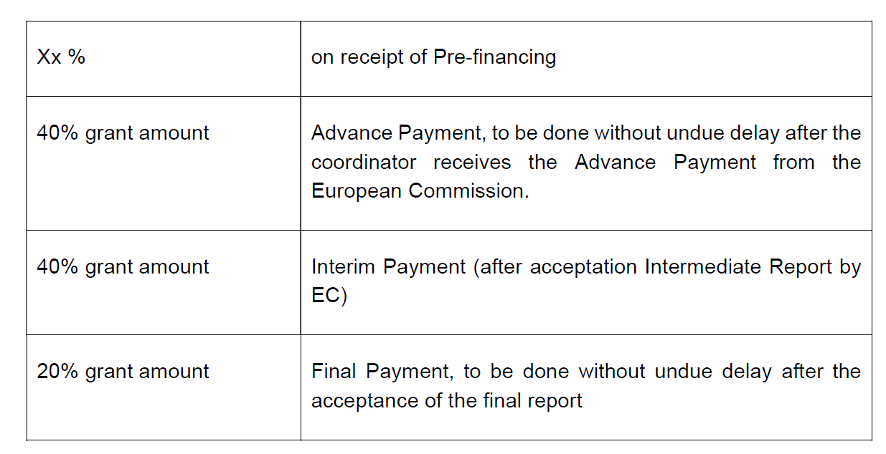

Project budget AIdesignTEX
PREFINANCING PAYMENTS
Funding of costs included in the Consortium Plan will be paid as agreed below:
PREFINANCING PAYMENTS
IN PROGRESS

Slide 18
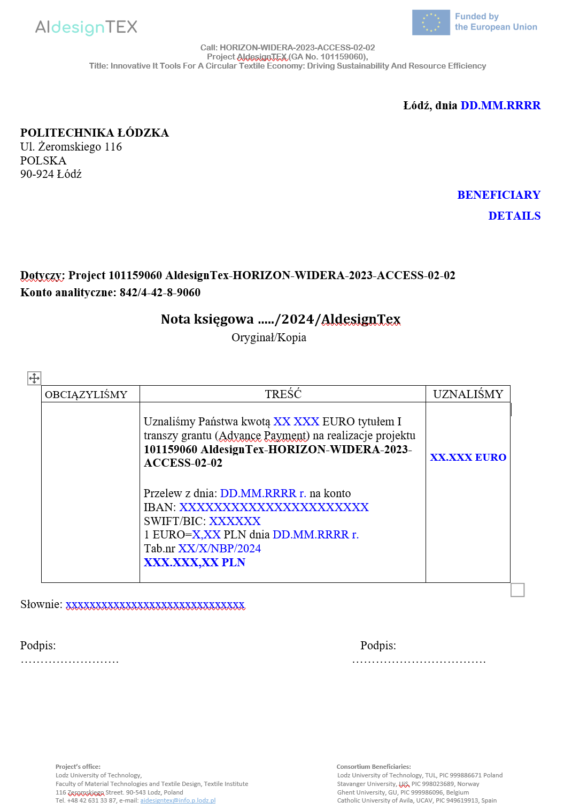
Project budget AIdesignTEX
PREFINANCING ACCOUNTING NOTES
After receiving advance payments, Project Partners are obliged to sign an accounting note confirming receipt of the payment

Slide 19
Project Work Plan and Partner Responsibilities
Anna Bacciarelli- Ulacha, Ph.D.
Monika Malinowska Olszowy, Associate Professor
Iwona Nowak, Ph.D.
Katarzyna Szypułka,
Lodz University of Technology​
Notes:
Now, we will move on the project work plan and partner responsibilities. The section of the presentation will be led by our team members: Anna Bacciarelli-Ulacha, Monika Malinowska_Olszowy , Iwona Nowak and Katarzyna Szypułka. The floor is yours.

Slide 20
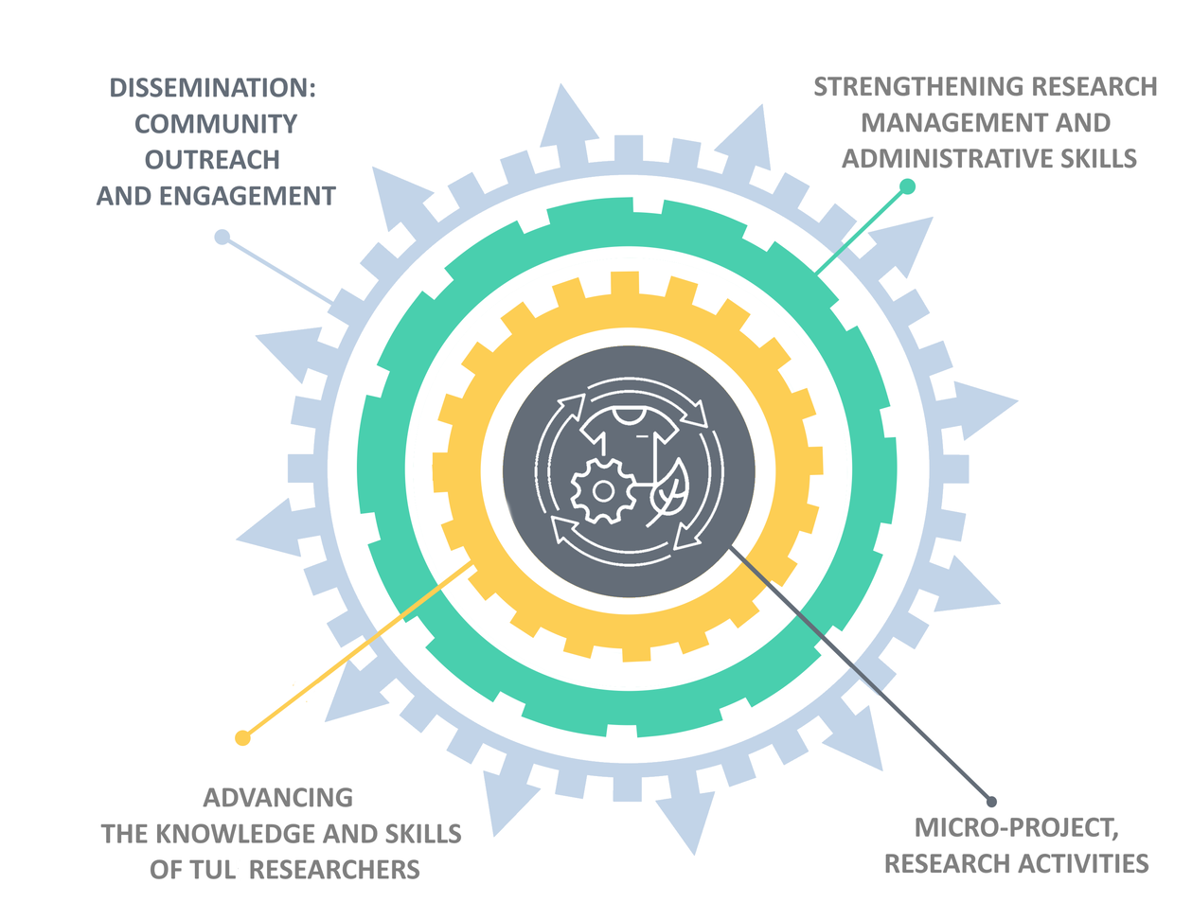
Project composition AIdesignTEX
Microproject: Circular Economy in Textile Production
Activities: Mentoring, long-term visits, summer schools for academic and administrative staff.
Focus: Use of Artificial Intelligence (AI) and Machine Learning (ML) tools to design textiles that meet Circular Economy criteria.
Goal: Create circular economy loops for textiles from various raw materials.
Impact: Solutions help producers implement sustainable practices—saving water, energy, minimizing waste, emissions, and pollutants.
Notes:
Welcome, everyone. In this part of the presentation, I will walk you through the detailed work plan for the AIdesignTEX project, and outline the specific responsibilities that each partner will undertake..
All activities aimed at developing the skills of the academic and administrative staff of the Faculty of Material Technologies and Textile Design, such as mentoring, long-term visits, summer schools, etc., in the project are centered around a microproject.
In the microproject, we aim to focus on improving the process of manufacturing textile products by using Artificial Intelligence or Machine Learning tools to design textiles that meet the criteria of the Circular Economy.
The main goal of the micro-project is to create circular economy loops for textiles made of various textile raw materials.
The solutions developed as a result of the project's work are intended to help producers implement technologies and practices that save water and energy, and minimize waste, greenhouse gas emissions and pollutants.

Slide 21






Key AIdesignTEX activities: Mentoring and Coaching AIdesignTEX
The responsibilities and activities during the program:
Cooperation on microproject,
Preparation of joint publications,
Participation in conferences,
Learning from mentors during exchange visits
The scheduled visits:
Long-term visits: 31 days in 2025,
Short-term visits: 10 days in 2026 and 10 days in 2027.
UG - Ghent University
Department of Materials, Textiles
and Chemical Engineering
UiS – University of Stavanger
Department of Mechanical and Structural Engineering and Materials Science (IMBM)
TUL - Łódź University
of Technology
Faculty of Materials Technologies
and Textile Design
UCAV - Catholic University of Avila Department of Entrepreneurship and Management
Notes:
In the AIdesignTEX project, we have a Mentoring and Coaching programe focused on skill development under the guidance of mentors from partner universities. We have selected the six reserchers from TUL to participate in the mentoring program .
Mentors from GU, UiS, and UCAV (one or two from each university) are responsible for communicating and cooperating with the selected researchers. These six participants will engage in both long- and short-term visits as part of their mentoring experience. Their responsibilities and activities during the program will include:
Cooperation on microprojects
Preparation of joint publications
Participation in conferences
Learning from mentors during exchange visits
The scheduled visits are as follows:
Long-term visits: 31 days in 2025 – we need to set the convinient date for this exchange ASAP
Short-term visits: 10 days in 2026 and 10 days in 2027.
These visits and collaborative activities aim to foster deeper cooperation, knowledge exchange, and professional growth within the framework of the AIdesignTEX project.

Slide 22
Key AIdesignTEX activities:
Educational Programs: Organizing summer schools and workshops focused on circular economy and AI/ML applications in textile design.
Collaboration with Third Countries: Developing links with universities and companies in Asia to promote sustainable practices and capacity building.
Marketing Campaign: Raising environmental awareness through online content, involving popular brands and influencers.
NGO Cooperation: Partnering with NGOs to support sustainable development and the circular economy.
Industry Collaboration: Establishing relationships with the textile and fashion industry to apply research and foster innovation.
Research Management and Administrative Skills Development: Enhancing the research management and administrative skills of TUL employees through study visits, workshops, and training sessions with advanced partner institutions.
Notes:
Education: We will organize summer schools and workshops for TUL researchers focused on topics related to the circular economy and the use of AI and ML tools in textile design. These sessions will include practical training and exercises to improve our scientists' skills in using advanced IT tools for textile product design. Additionally, we plan to host international conferences and other educational events, such as an Ecological Picnic, to raise awareness about sustainable textile production.
Collaboration with Third Countries: We aim to develop cooperation with universities and companies in Asian countries, specifically Bangladesh and Sri Lanka. Our plan includes organizing webinars and participating in international conferences to promote sustainable textile design and circular economy practices while supporting local capacity building. We hope that you will engage with this part of the project, as this collaboration can significantly contribute to the development of the circular economy in countries with high textile production.
Marketing Campaign: We will implement an educational campaign on our project website and social media platforms to raise awareness of environmental issues and sustainable development. Through articles, infographics, and videos, we aim to educate stakeholders and promote a vision for a sustainable future. Additionally, we will engage popular brands and influencers to spread the project’s ideas and promote sustainable fashion, especially among younger audiences.
Collaboration with Non-Governmental Organizations (NGOs): An essential element of the AIdesignTEX project is our collaboration with NGOs dedicated to sustainable development, environmental protection, and the promotion of the circular economy.
Collaboration with Companies: We are building solid foundations for cooperation with the business sector, especially with companies in the textile and fashion industries. We will organize Round Table for the industry representatives. Our goal is not only to implement research findings into industrial practices but also to support innovation and sustainable development across the sector.
Research Management and Administrative Skills Development: We are enhancing the research management and administrative skills of TUL employees through study visits, workshops, and training sessions with advanced partner institutions. This includes improving the preparation of project applications, strengthening project management and administration processes, and increasing participation in international programs such as Horizon Europe. Our key activities involve analyzing best practices, creating useful guidelines, and organizing events like the Joint Summer School and a seminar on research management.

Slide 23
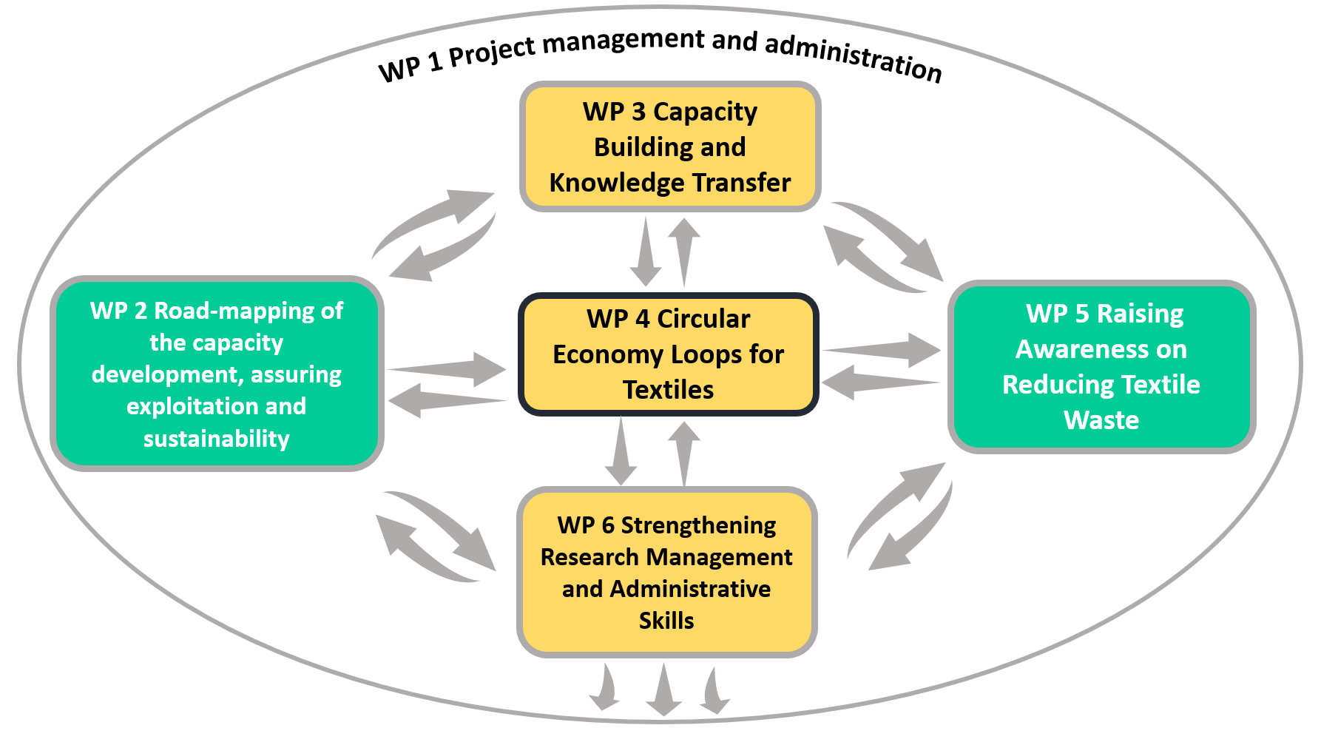
Work Plan Overview AIdesignTEX
A diagram showing the six WPs connected to the central project objective
Notes:
We are now familiar with the key activities of our project, and all of them are placed within the appropriate work packages. I would now like to present the work plan for these activities, with a breakdown of the responsibilities for each partner in the project.
The work plan of the AIdesignTEX project is structured into six work packages (WPs), each addressing specific objectives critical to achieving the project's overall goals.
WP1: Project Management and Administration
WP2: Capacity Development, Exploitation, and Sustainability
WP3: Capacity Building and Knowledge Transfer
WP4: Circular Economy Loops for Textiles
WP5: Raising Awareness on Reducing Textile Waste and Promoting Sustainable Textile Production
WP6: Strengthening Research Management and Administrative Skills

Slide 24
WP1: Project Management and Administration AIdesignTEX
Objective: To ensure effective coordination, organization, and administration of the AIdesignTEX project.
Key Tasks: | Deliverables:
Project organization and management Decision-making and internal communication within the consortium Project progress monitoring and reporting | Project organization and management plan (D1, due M3) Progress Report (D2, due M17)
Partner: | Responsibilities:
TUL: Lead Partner | Project management, organization of meetings, reporting, internal consortium communication, progress monitoring.
Involved Partners: UiS, GU, UCAV | Supporting project management, participating in meetings, providing information for reports.
Notes:
This slide outlines the key tasks, deliverables, and responsibilities within Work Package 1 (WP1), focused on project management and administration. TUL, as the lead partner, is responsible for overseeing project organization, decision-making, and internal communication within the consortium, as well as monitoring and reporting on project progress. Deliverables include the Project Management Plan and a Progress Report. Involved partners (UiS, GU, UCAV) will support project management by participating in meetings and providing necessary information for reporting.

Slide 25
WP2: Capacity Development, Exploitation, and Sustainability AIdesignTEX
Objective: To establish a framework for the development, exploitation, and long-term sustainability of project outcomes
Key Tasks: | Deliverables:
Developing a communication strategy and online platform Creating a vision plan for future research and innovation Preparing a strategic post-project networking agenda | Communication and exploitation plans (D3, due M6, updated version D8, due M35) Future vision plan for research and innovation (D4, due M36) Strategic Post-Twinning Programme of Networking and Cooperation and its Work Plan for the first five years (D5, due M36) Data management plans (D6 due M6 , updated version D7due M34)
Partner: | Responsibilities:
UiS: Lead Partner | Development of Data Management Plan, Development of The Future Vision Plan, Development of a communication strategy, Preparation of a strategic plan for post-project implementation.
Involved Partners: TUL, GU, UCAV | Participation in the development of a long-term strategy, Creation of an online platform, collaboration in communication activities, organization of short-term visits and workshops.
Notes:
Work Package 2 (WP2) focuses on capacity development, exploitation, and sustainability. Key tasks include developing a communication strategy and online platform, creating a vision plan for future research and innovation, and preparing a strategic post-project networking agenda. The deliverables include communication and exploitation plans, a vision for future research, a strategic post-twinning networking program, and data management plans. UiS, as the lead partner, is responsible for developing these strategies and plans, while involved partners TUL, GU, UCAV) will support the creation of long-term strategies, collaborate on communication activities, and organize short-term visits and workshops

Slide 26
WP3: Capacity Building and Knowledge Transfer AIdesignTEX
Objective: To enhance knowledge and skills in circular economy practices and advanced IT tools.
and IT tools (D10, D11, D13)
Key Tasks: | Deliverables:
Conducting needs assessments Organizing workshops and training on circular economy and IT tools Supporting knowledge exchange through short-term visits Attending conferences and seminars | Needs assessment report (D9, due M6) Reports from workshops and training sessions on circular economy (D10,) Reports from workshops and training sessions on advancedIT tools (D11) Report on short-term visits for knowledge exchange (D12) Mentoring and coaching support for researchers – Report (D13)
Partner: | Responsibilities:
TUL: Lead Partner | Conducting a needs analysis in cooperation with partners Organizing workshops and training on circular economy and IT tools Participating in mentoring, seminars, and workshops organized by the partners,
Notes:
Work Package 3 (WP3) focuses on capacity building and knowledge transfer with the objective of enhancing knowledge and skills in circular economy practices and advanced IT tools. The key tasks include conducting needs assessments, organizing workshops and training sessions, supporting knowledge exchange through short-term visits, and attending conferences and seminars.
The deliverables consist of reports on needs assessments, workshops, and training sessions related to circular economy and advanced IT tools, as well as mentoring and coaching support for researchers. TUL, as the lead partner, is responsible for conducting the needs analysis and participating in mentoring and workshops, with support from involved partners (UiS, GU, UCAV).

Slide 27
WP3: Capacity Building and Knowledge Transfer AIdesignTEX
Objective: To enhance knowledge and skills in circular economy practices and advanced IT tools.
and IT tools (D10, D11, D13)
Partner: | Responsibilities:
UiS | Responsible for preparing sessions on textile product development and using artificial intelligence in the textile design phase. Supporting TUL in knowledge transfer and practices in textile design with AI. Responsible for mentoring and coaching 2 TUL researchers.
GU | Preparing demonstration experiments to assess the recyclability of textile products. Supporting TUL in knowledge exchange related to textile recycling. Responsible for mentoring and coaching 2 TUL researchers.
UCAV | Organizing 3 sessions on the application of artificial intelligence in various manufacturing sectors, including theoretical and practical parts. Preparing seminars on the circular economy and new technologies for project members and academic communities of partner institutions. Responsible for mentoring and coaching 2 TUL researchers, focusing on the circular economy and application of new technologies.
Notes:
In this project, each partner has specific responsibilities that contribute to the overall objectives. TUL (Łódź University of Technology) leads the WP, overseeing tasks such as needs assessment, organizing workshops, training sessions, short-term visits, and mentoring programs. GU (Ghent University) is responsible for conducting experiments on the recyclability of textiles and providing mentoring and coaching to TUL researchers in the area of recycling technologies. UiS (University of Stavanger) focuses on preparing sessions related to textile product development and the use of artificial intelligence in the design process, while also mentoring TUL researchers in the application of advanced IT and AI tools for textiles. Lastly, UCAV (Catholic University of Ávila) organizes sessions on the application of artificial intelligence in various sectors and seminars on the circular economy, providing mentoring to TUL researchers in circular economy practices and new technological approaches.

Slide 28
WP4: Circular Economy Loops for Textiles AIdesignTEX
Objective: To conduct a collaborative micro-project that will result in circular economy loops for textiles made of various textile raw materials by utilizing artificial intelligence and machine learning tools to develop textiles that are more easily recyclable and sustainable.
Key Tasks: | Deliverables:
Conducting a literature review on circular economy principles and AI/ML tools for textile recycling. Analyzing textile raw materials for recyclability and biodegradability. Developing AI and ML models to optimize textile design for circularity. Designing and testing of textile prototypes for recyclability and biodegradability. Preparing strategies and action plans for circular economy loops in selected textiles. | Material analysis and selection report (D14, due M15) AI and ML model development (D15, due M32) Prototype development and testing (D16, due M34) Circular economy loop strategies and action plans for selected textiles (D17, due M36)
ADDITIONAL ACTIVITIES | 7 article publications in journals from ISI Master Journal List (D24),
Notes:
The slide outlines the key tasks and deliverables of Work Package 4 (WP4), focusing on developing circular economy loops for textiles. Key activities include literature review, material analysis, AI/ML model development, prototype design, and preparing circular economy strategies. The expected outcomes include reports, AI models, prototypes, and action plans for implementing circular economy loops in textiles.

Slide 29
WP4: Circular Economy Loops for Textiles AIdesignTEX
Objective: To conduct a collaborative micro-project that will result in circular economy loops for textiles made of various textile raw materials by utilizing artificial intelligence and machine learning tools to develop textiles that are more easily recyclable and sustainable.
Partner: | Responsibilities:
TUL: Lead Partner | Leads literature review, circular economy loop preparation, and contributes to material analysis and prototype testing.
GU | Leads material analysis and selection, evaluates recyclability and biodegradability.
UiS | Leads AI and ML model development, as well as prototype development and testing.
UCAV | Co-leads AI model development and supports prototype development and circular economy strategies.
Notes:
The slide outlines the responsibilities of the partners in Work Package 4 (WP4), which focuses on circular economy loops for textiles. TUL, as the lead partner, is responsible for the literature review, preparation of circular economy strategies, and conducting material analysis.
GU is responsible for training in material analysis and the evaluation of recyclability and biodegradability.
UiS teaches us how to work with AI and ML models and supports prototype testing, while UCAV co-leads the development of AI/ML models and supports the creation of circular economy strategies.
Now, I would like to hand over the presentation to my colleague from our team, Monika, who will take it from here. Monika, the floor is yours.

Slide 30
WP5: Raising Awareness on Reducing Textile Waste and Promoting Recycling and Sustainable Textile Production AIdesignTEX
Objective: To raise awareness on reducing textile waste and promoting recycling and sustainable textile production through various strategies and activities
Key Tasks: | Deliverables:
Developing educational campaigns and resources Supporting intercultural dialogue and collaboration Engaging with local stakeholders and sharing knowledge internationally | Educational and informational campaigns (D18, M36) Engaging of the Local Stakeholders unless 3 agreement (D19, M36) (Roundtable discussions and stakeholder engagements (A22, A23, A25)) Knowledge sharing in third countries (Asia) – unless 1 agreement (D20, M36)
Other activities:
Cooperation with influencers with high numbers of followers Preparation of customer behaviour survey and incorporated into the awareness campaign Organization of event The World Day of Recycling containing workshop and forum, that bring together perspectives and ideas on sustainability from diverse backgrounds (online event) Organization of International Conference – “International Conference on Circular Economy in Textiles: Shifting Towards Sustainable and Regenerative Practices” Organization of online workshop for 3rd countries to educate local stakeholders about sustainable textile design and circular economy practices. Creation of educational resources, such as online course, training manuals, and videos, that are tailored to the needs and interests of stakeholders in 3rd countries. Participate in international conferences and events to share the consortium's knowledge about CE and experiences with other experts and stakeholders in these countries (2 conferences in Asia in the last year of the project) to establish partnerships with local universities.
Notes:
In English: Work Package 5 (WP5) of the AIdesignTEX project, aims to raise awareness about reducing textile waste and promoting recycling and sustainable textile production. The key tasks include developing educational campaigns, supporting intercultural dialogue, and engaging local stakeholders to share knowledge internationally. The expected deliverables include educational campaigns, local stakeholder engagement, and knowledge sharing in third countries (mainly in Asia). Additional activities involve collaborating with influencers, organizing international conferences and workshops, and creating educational resources tailored to the needs of stakeholders in third countries.

Slide 31
WP5: Raising Awareness on Reducing Textile Waste and Promoting Recycling and Sustainable Textile Production AIdesignTEX
Objective: To raise awareness on reducing textile waste and promoting recycling and sustainable textile production through various strategies and activities
Partner: | Responsibilities:
TUL | Leads educational and informational campaigns (Task 5.1). Organizes intercultural events and conferences (Task 5.2). Engages local stakeholders and organizes events (Task 5.3).
UiS | Leads dissemination through research publications (Task 5.4). Leads knowledge sharing in third countries (Task 5.5).
GU | Supports dissemination and collaborations through academic networks.
UCAV | Supports event organization, stakeholder engagement, and research dissemination.
Notes:
In English: This slide outlines the responsibilities of partners within WP5 of the AIdesignTEX project, which focuses on raising awareness about reducing textile waste and promoting recycling and sustainable textile production. TUL is responsible for leading educational and informational campaigns (Task 5.1), organizing intercultural events and conferences (Task 5.2), and engaging local stakeholders (Task 5.3). UiS leads dissemination through research publications (Task 5.4) and knowledge sharing in third countries (Task 5.5). GU supports dissemination and collaborations through academic networks, while UCAV supports event organization, stakeholder engagement, and research dissemination.

Slide 32
WP6: Strengthening Research Management and Administrative Skills
AIdesignTEX
To strengthen the research management and administrative skills of TUL employees by studying the specifics of research management and administration in advanced partner institutions, improving the preparation of project applications, project management/administration skills, and increasing participation in the project under the Horizon Europe program and other international programs.
Key Tasks: | Deliverables:
Analyzing research management practices Providing training and capacity-building programs Improving project proposal preparation and administration skills Enhancing participation in international programs | The Gender Equality Plan Advancement vol.2 (D21, M14) Research Management and Administration for TUL – FAQ (D22, M21) Project application preparation guidelines (D23, M26)
Other Activities
Seminar: "Strengthening research management and administration; experience and prospects" (2-day event at TUL for 50 participants, remote mode option). Visits: 3x 1-day visits of the TUL academic leadership to each advanced partner. Workshops: 3x 3-hour workshops in the form of videoconferences. Joint Summer School: "Effective Management of EU Projects within Horizon Europe: From Concept to Success" (5 days, each day 5 hours of classes) at UCAV Project Applications: Preparation and submission of 2 international research grants
Notes:
In English: This slide presents the key tasks, deliverables, and other activities within Work Package 6 (WP6) of the AIdesignTEX project, which focuses on strengthening research management and administrative skills at TUL. The main tasks include analyzing research management practices, providing training, and improving project proposal preparation skills. The expected deliverables include the update of the Gender Equality Plan, a FAQ on research management for TUL, and project application preparation guidelines. Additional activities include a seminar on research management, study visits by TUL's academic leadership, and a joint summer school held at UCAV.

Slide 33
WP6: Strengthening Research Management and Administrative Skills
AIdesignTEX
Partner: | Responsibilities:
UCAV: Lead Partner | Developing and delivering training programs to enhance TUL employees' research management and administrative skills. Providing expert trainers and mentors from UCAV and advanced partners. Organizing the workshop at UCAV, the Joint Summer School in Poland, and the seminar at TUL.
TUL: | Leading the study tour of TUL researchers to foreign Twinning Partners. Analyzing research management and administration practices at advanced partner institutions. Identifying best practices, processes, tools, and organizational structures for research management and administration. Preparing the “Research Management and Administration for TUL – FAQ” and contributing to the “Gender Equality Plan Advancement vol.2.” Facilitating TUL’s participation in the Horizon Europe program and other international programs by jointly preparing 2 scientific projects.
UiS, GU, Support Role in Task 6.1 & Task 6.3 | Providing best practices and organizational insights related to research management and administration. Supporting TUL in identifying appropriate calls for proposals and developing project ideas. Assisting in the preparation of project applications and supporting TUL’s increased participation in international programs.
Notes:
In English: This slide outlines the responsibilities of partners within WP6 of the AIdesignTEX project. UCAV serves as the lead partner, responsible for developing and delivering training programs, providing expert trainers, and organizing the workshop at UCAV, the Joint Summer School in Poland, and the seminar at TUL. TUL is responsible for leading study tours, analyzing research management practices, preparing the FAQ on research management, and participating in the preparation of two scientific projects. UiS and GU support TUL by providing best practices, helping identify appropriate calls for proposals, and assisting in the preparation of project applications.

Slide 34
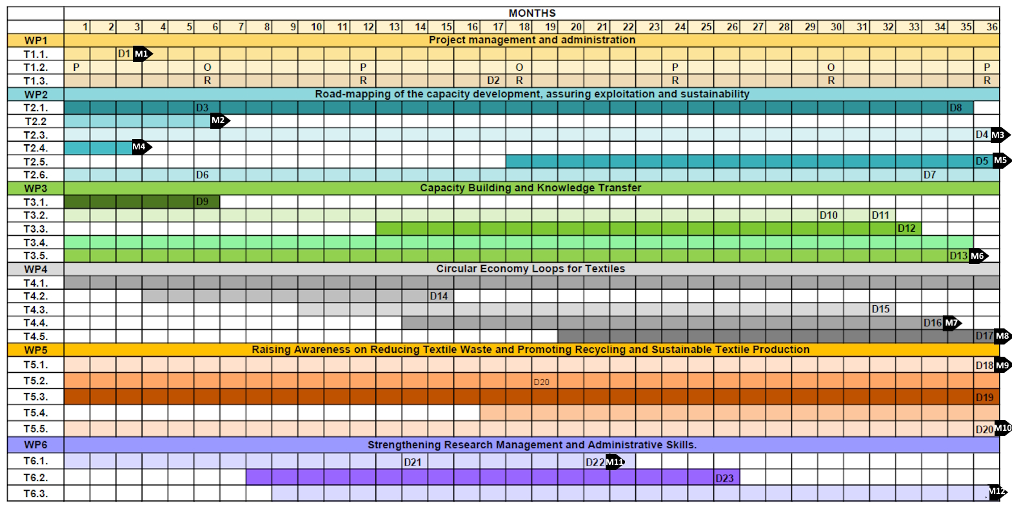
List of Milestones
Notes:
Na tym slajdzie mamy zestawienie harmonogramu projektu, który obejmuje kluczowe zadania i kamienie milowe w ramach poszczególnych pakietów pracy (WP1–WP6). Projekt trwa 36 miesięcy. Każdy wp tez trwa 36 msc. Kamienie milowe są oznaczone na harmonogramie jako M1, M2 itd., i odpowiadają określonym punktom w czasie realizacji projektu, wskazując na istotne osiągnięcia, które muszą zostać zrealizowane.
Na przykład:
M1 (oznaczone na slajdzie w 3. miesiącu) odnosi się do "Project Organization and Management Plan (D1)", co jest pierwszym kamieniem milowym w WP1. Jest to kluczowy dokument, który potwierdza, że struktura zarządzania projektem została ustanowiona i zatwierdzona.
M2 (6. miesiąc) dotyczy "Website with Online Communication Platform for Collaboration and Information Sharing (D3)" w WP2, który zakłada uruchomienie strony internetowej oraz platformy komunikacyjnej dla partnerów projektu.
M3 (18. miesiąc) związane jest z "Future Vision Plan (D4)" w WP2, który określa długoterminową wizję i kierunki badawcze oraz innowacyjne projektu.
M4 (24. miesiąc) oznacza "Report on Short-term Expert Visits and Networking Activities Accepted by GA (D5)", kluczowy raport zatwierdzony przez Zgromadzenie Ogólne.M5 (36. miesiąc) odnosi się do "Strategic Post-Twinning Programme (D6)", który zawiera plan współpracy na kolejne pięć lat po zakończeniu projektu Twinning.
M6 obejmuje różne rezultaty WP3 związane ze szkoleniami i podnoszeniem kwalifikacji, takie jak "Report from Workshop and Training Sessions on Circular Economy (D9)" oraz inne raporty szkoleniowe.
M7 skupia się na wynikach badań i innowacjach, takich jak "Material Analysis and Selection Report (D14)", oraz na innych działaniach związanych z obiegiem zamkniętym.
M8 (36. miesiąc) dotyczy strategii obiegu zamkniętego, jak np. "Circular Economy Loop Strategies and Action Plans for Selected Textiles (D18)".
M9 związane jest z działaniami edukacyjnymi, np. "Educational/Informational Campaign and Analysis of its Results (D19)".M10 odnosi się do dzielenia się wiedzą w krajach docelowych, jak np. "Knowledge Sharing in Third Countries (D20)".
M11 dotyczy FAQ dla TUL, tj. "Research Management and Administration for TUL – FAQ (D22)".
M12 obejmuje przygotowanie wniosków o dwa międzynarodowe granty badawcze, kończąc proces aplikacji.Rezultaty projektu są oznaczone jako D1-D23 i są kluczowymi wyjściami pracy w poszczególnych pakietach, mających na celu zapewnienie, że projekt osiągnie swoje cele badawcze i strategiczne. Każdy z tych kamieni milowych jest kluczowy dla monitorowania postępu projektu i zapewnienia, że wszystkie założone cele zostaną osiągnięte zgodnie z harmonogramem.
Wylitowane rezultaty znajdą Państwo na następnym slajdzie.

Slide 35
List of Milestones
Milestone number | Milestone name/deliverables | Related WP | Due date (in month) | Means of verification
M1 | Project Organization and Management Plan (D.1) | WP1 | 3 | document
M2 | Website with Online communication platform for collaboration and information sharing (D.3) | WP2 | 6 | on project website
M3 | Future Vision Plan (D.4) | WP2 | 36 | document
M4 | Report on short-term expert visits and networking activities accepted by GA (D.5) | WP2 | 3 | document
M5 | Strategic Post-Twinning Programme (D.6) | WP2 | 36 | document
M6 | Training and Skills Enhancement (D.9, 10, 11, 12, 13) | WP3 | 35 | document
M7 | Research Outputs and Innovation (D.14, 15, 16, 17) | WP4 | 34 | document
M8 | Circular Economy Loop Strategies (D.18) | WP4 | 36 | document
M9 | Educational Campaign and Analysis (D. 19) | WP5 | 36 | document
M10 | Knowledge Sharing in Target Countries (D.24) | WP5 | 36 | document
M11 | Research Management and Administration for TUL – FAQ (D.22) | WP6 | 21 | document
M12 | Application 2 international grants for research projects | WP6 | 36 | document
Notes:
Ten slajd przedstawia kluczowe kamienie milowe w ramach projektu, które wyznaczają istotne momenty i osiągnięcia, jakie muszą zostać zrealizowane w trakcie jego trwania. Oto główne kamienie milowe:
M1: Plan organizacji i zarządzania projektem (D.1) - To pierwszy kamień milowy, który został osiągnięty na początku projektu. Jego celem jest ustalenie struktury zarządzania i organizacji pracy w projekcie.
M2: Strona internetowa z platformą komunikacji online (D.3) - W 6. miesiącu projektu planowane jest uruchomienie strony internetowej, która będzie pełnić funkcję platformy komunikacyjnej do współpracy i wymiany informacji między partnerami.
M3: Plan Wizji na Przyszłość (D.4) - Kamień milowy związany z opracowaniem dokumentu określającego długoterminową wizję rozwoju projektu i jego rezultatów.
M4: Raport z wizyt ekspertów i działań networkingowych (D.5) - To kamień milowy, który polega na zatwierdzeniu raportu z krótkoterminowych wizyt ekspertów i działań networkingowych, co nastąpi po ich zakończeniu.
M5: Strategiczny Program Post-Twinning (D.6) - Kamień milowy, który ustanawia długoterminowe strategie współpracy po zakończeniu projektu Twinning.
M6: Szkolenia i Podnoszenie Kwalifikacji (D.9, 10, 11, 12, 13) - Obejmuje szereg działań szkoleniowych mających na celu podniesienie kwalifikacji uczestników projektu.
M7: Wyniki Badań i Innowacje (D.14, 15, 16, 17) - Ten kamień milowy dotyczy publikacji wyników badań i innowacji wynikających z projektu.
M8: Strategie Obiegu Zamkniętego (D.18) - Opracowanie strategii dla obiegu zamkniętego tekstyliów jest kluczowym elementem projektu, którego osiągnięcie przewidziane jest w późniejszym etapie.
M9: Kampania Edukacyjna i Analiza (D.19) - Kamień milowy związany z przeprowadzeniem kampanii edukacyjnej i przygotowaniem analizy jej efektów.
M10: Dzielenie się Wiedzą w Krajach Docelowych (D.24) - Dotyczy działań związanych z przekazywaniem wiedzy w krajach docelowych, szczególnie w kontekście promowania zrównoważonych praktyk.
M11: Zarządzanie badaniami i administracją dla TUL – FAQ (D.22) - Opracowanie i dystrybucja FAQ dotyczącego zarządzania badaniami w TUL, co ma pomóc w usprawnieniu procesów administracyjnych.
M12: Aplikacje o 2 międzynarodowe granty na projekty badawcze - Ostateczny kamień milowy, który zakłada złożenie dwóch wniosków o międzynarodowe granty, wspierających dalsze badania wynikające z projektu.

Slide 36
Upcoming Activities for the Next Six Months
Number | Deliverables/activities | Related WP | Start date | Due date | Means of verification
D1 | Well-structured project organization and management plan | WP1 | 01.10.2024 | 20.12.2024 | Raport
D2 | Dissemination and Exploitation Plan, including communication activities | WP1 | 01.10.2024 | 31.03.2025 | Report
D6 | Data management plan (DMP) | WP2 | 01.10.2024 | 31.03.2025 | Report
D9 | Needs assessment report on knowledge and skills gaps | WP3 | 01.10.2024 | 31.03.2025 | Report
A1 | First kick-off meeting for all partners in Lodz, Poland | WP1 | 01.10.2024 | 13.10.2024 | Event
A8 | Two 2-day short-term visits of 5 TUL (3 management representatives and 2 researches under mentoring programme) to each partner | WP2 | 01.10.2024 | 31.12.2024 | Event
A9 | The Website with Online Communication Platform | WP2 | 01.10.2024 | 31.12.2024 | WebPage
A14 | Mentoring and coaching support for researchers - Conducting a literature review onrecycling, circular economy principles and AI/ML tools for textile recycling. | WP3 | 01.10.2024 | 31.12.2024 | Article
A20 | Promotional and educational campaign - Cooperation with influencers with high numbers of followers | WP5 | 01.10.2024 | 30.09.2027 | Campaign analysis report
A24 | Round Table 1 | WP5 | 21.01.2025 | 25.01.2025 | Event
A15 | Set a convenient date for Long term visits (1 month 1st year). During these visits the following activities will be organized: 3 sessions in UCAV, 3 workshops by UiS, 3 laboratory experiments in GU. | WP3 | 01.10.2024 | 31.11.2024 | -
Notes:
In this slide, we highlight the critical upcoming activities that need to commence with the project's launch. Many of these tasks fall under the responsibility of the project leader, but we kindly request all partners to actively participate and contribute to their successful completion.
D1: Well-structured project organization and management plan – due date: 20.12.2024
D2: Dissemination and Exploitation Plan, including communication activities – due date: 31.03.2025
D6: Data management plan (DMP) – due date: 31.03.2025D9: Needs assessment report on knowledge and skills gaps – due date: 31.03.2025
Several important activities are also planned:
A1: First kick-off meeting for all partners – now in Łódź, Poland.
A8: Two short-term, 2-day visits of five TUL representatives (3 management and 2 researchers under the mentoring program) to each partner.
A9: Launch of the Website with Online Communication Platform – due by 31.12.2024.
A14: Mentoring and coaching support for researchers – this includes conducting a literature review on recycling, circular economy principles, and AI/ML tools for textile recycling, to be completed by 31.12.2024.
A20: Promotional and educational campaign – in collaboration with influencers with a large following.
A24: Round Table 1 – scheduled for 21.01.2025 will take place alongside the InovaTex 2025 conference, organized by Mr. Marcin Barburski.
A15: Setting a convenient date for long-term visits in the first year, where the following activities will be organized: 3 sessions at UCAV, 3 workshops at UiS, and 3 laboratory experiments at GU.
By collaborating closely, we will ensure that all these activities are completed on time, helping us stay aligned with our project's goals.

Slide 37
Q&A Session
Lodz University of Technology​
Notes:
If you have any questions or concerns regarding the topics we've discussed, now is the perfect time to address them. I invite you to ask your questions so we can clarify any doubt.

Slide 38
AIdesignTEX
© Templateswise.com
Thank you
Coordinator :
prof. Katarzyna Grabowska, e-mail: katarzyna.grabowska@p.lodz.pl
Dean of Faculty of Materials Technologies and Textile Design
Notes:
Po polsku:
Dziękuję wszystkim za aktywny udział w dzisiejszym spotkaniu. Podsumowując, omówiliśmy kluczowe aspekty projektu, w tym harmonogram zadań, kamienie milowe oraz oczekiwane rezultaty.
Co dalej?
Realizacja zadań: Każdy zespół powinien teraz skupić się na realizacji zadań przypisanych w harmonogramie. Przypominam, że terminy są ściśle określone, a ich dotrzymanie jest kluczowe dla sukcesu całego projektu.
Komunikacja: Proszę pamiętać o regularnej komunikacji, zarówno wewnątrz zespołów, jak i między partnerami projektu. Platforma komunikacyjna online, która zostanie uruchomiona w 6. miesiącu, będzie kluczowym narzędziem do wymiany informacji i współpracy.
Monitoring postępów: Proszę o regularne raportowanie postępów zgodnie z ustalonym harmonogramem. Kamienie milowe są strategicznymi punktami, które będą monitorowane, aby zapewnić, że projekt jest realizowany zgodnie z planem.Wsparcie: Jeśli napotkacie na jakiekolwiek wyzwania, nie wahajcie się zwrócić o wsparcie do koordynatora projektu lub innych zespołów. Współpraca jest kluczowa.
Zakończenie: Na tym etapie jesteśmy dobrze przygotowani, aby kontynuować realizację projektu z pełnym zaangażowaniem. Jestem przekonana, że dzięki wspólnym wysiłkom osiągniemy nasze cele.
Czekam na kolejne spotkanie, podczas którego omówimy postępy i będziemy kontynuować naszą pracę nad tym ambitnym projektem. Jeszcze raz dziękuję za udział i życzę wszystkim powodzenia w realizacji zadań.
Po angielsku:
Thank you all for your active participation in today’s meeting. To summarize, we discussed the key aspects of the project, including the task schedule, milestones, and expected deliverables.
What’s next?
Task Execution: Each team should now focus on executing the tasks assigned in the schedule. Please remember that deadlines are strict, and meeting them is crucial for the success of the entire project.
Communication: Please ensure regular communication, both within teams and between project partners. The online communication platform, which will be launched in the 6th month, will be a key tool for information exchange and collaboration.
Progress Monitoring: Regular progress reporting according to the established schedule is essential. Milestones are strategic points that will be monitored to ensure the project is on track.
Support: If you encounter any challenges, don’t hesitate to reach out for support from the project coordinator or other teams. Collaboration is key.Closing: At this stage, we are well-prepared to continue project implementation with full commitment.
I am confident that through our collective efforts, we will achieve our goals.I look forward to our next meeting, where we will discuss progress and continue our work on this ambitious project. Once again, thank you for your participation, and I wish everyone success in carrying out your tasks

